Slide 1
Laboratory testing of monoclonal gammopathy
What tests to order and how to interpret them

Slide 2
Presenter Disclosure
Faculty / Speaker’s name: Arvand Barghi
Relationships with commercial interests:
  None
Notes:
This slide must be visually presented to the audience AND verbalized by the speaker.

Slide 3
Mitigating Potential Bias
Not applicable
Notes:
This slide must be visually presented to the audience AND verbalized by the speaker.

Slide 4
Learning Objectives
Review the structure and function of immunoglobulins and the patterns of polyclonal and monoclonal gammopathies
Discuss the laboratory tests pertaining to immunoglobulin investigation
Review the appropriate laboratory tests to order in the setting of screening for suspected plasma cell dyscrasia

Slide 5
Review of lab tests pertaining to immunoglobulin status
Serum protein electrophoresis
Serum free light chains
Urine protein electrophoresis
Quantitative immunoglobulins

Slide 6
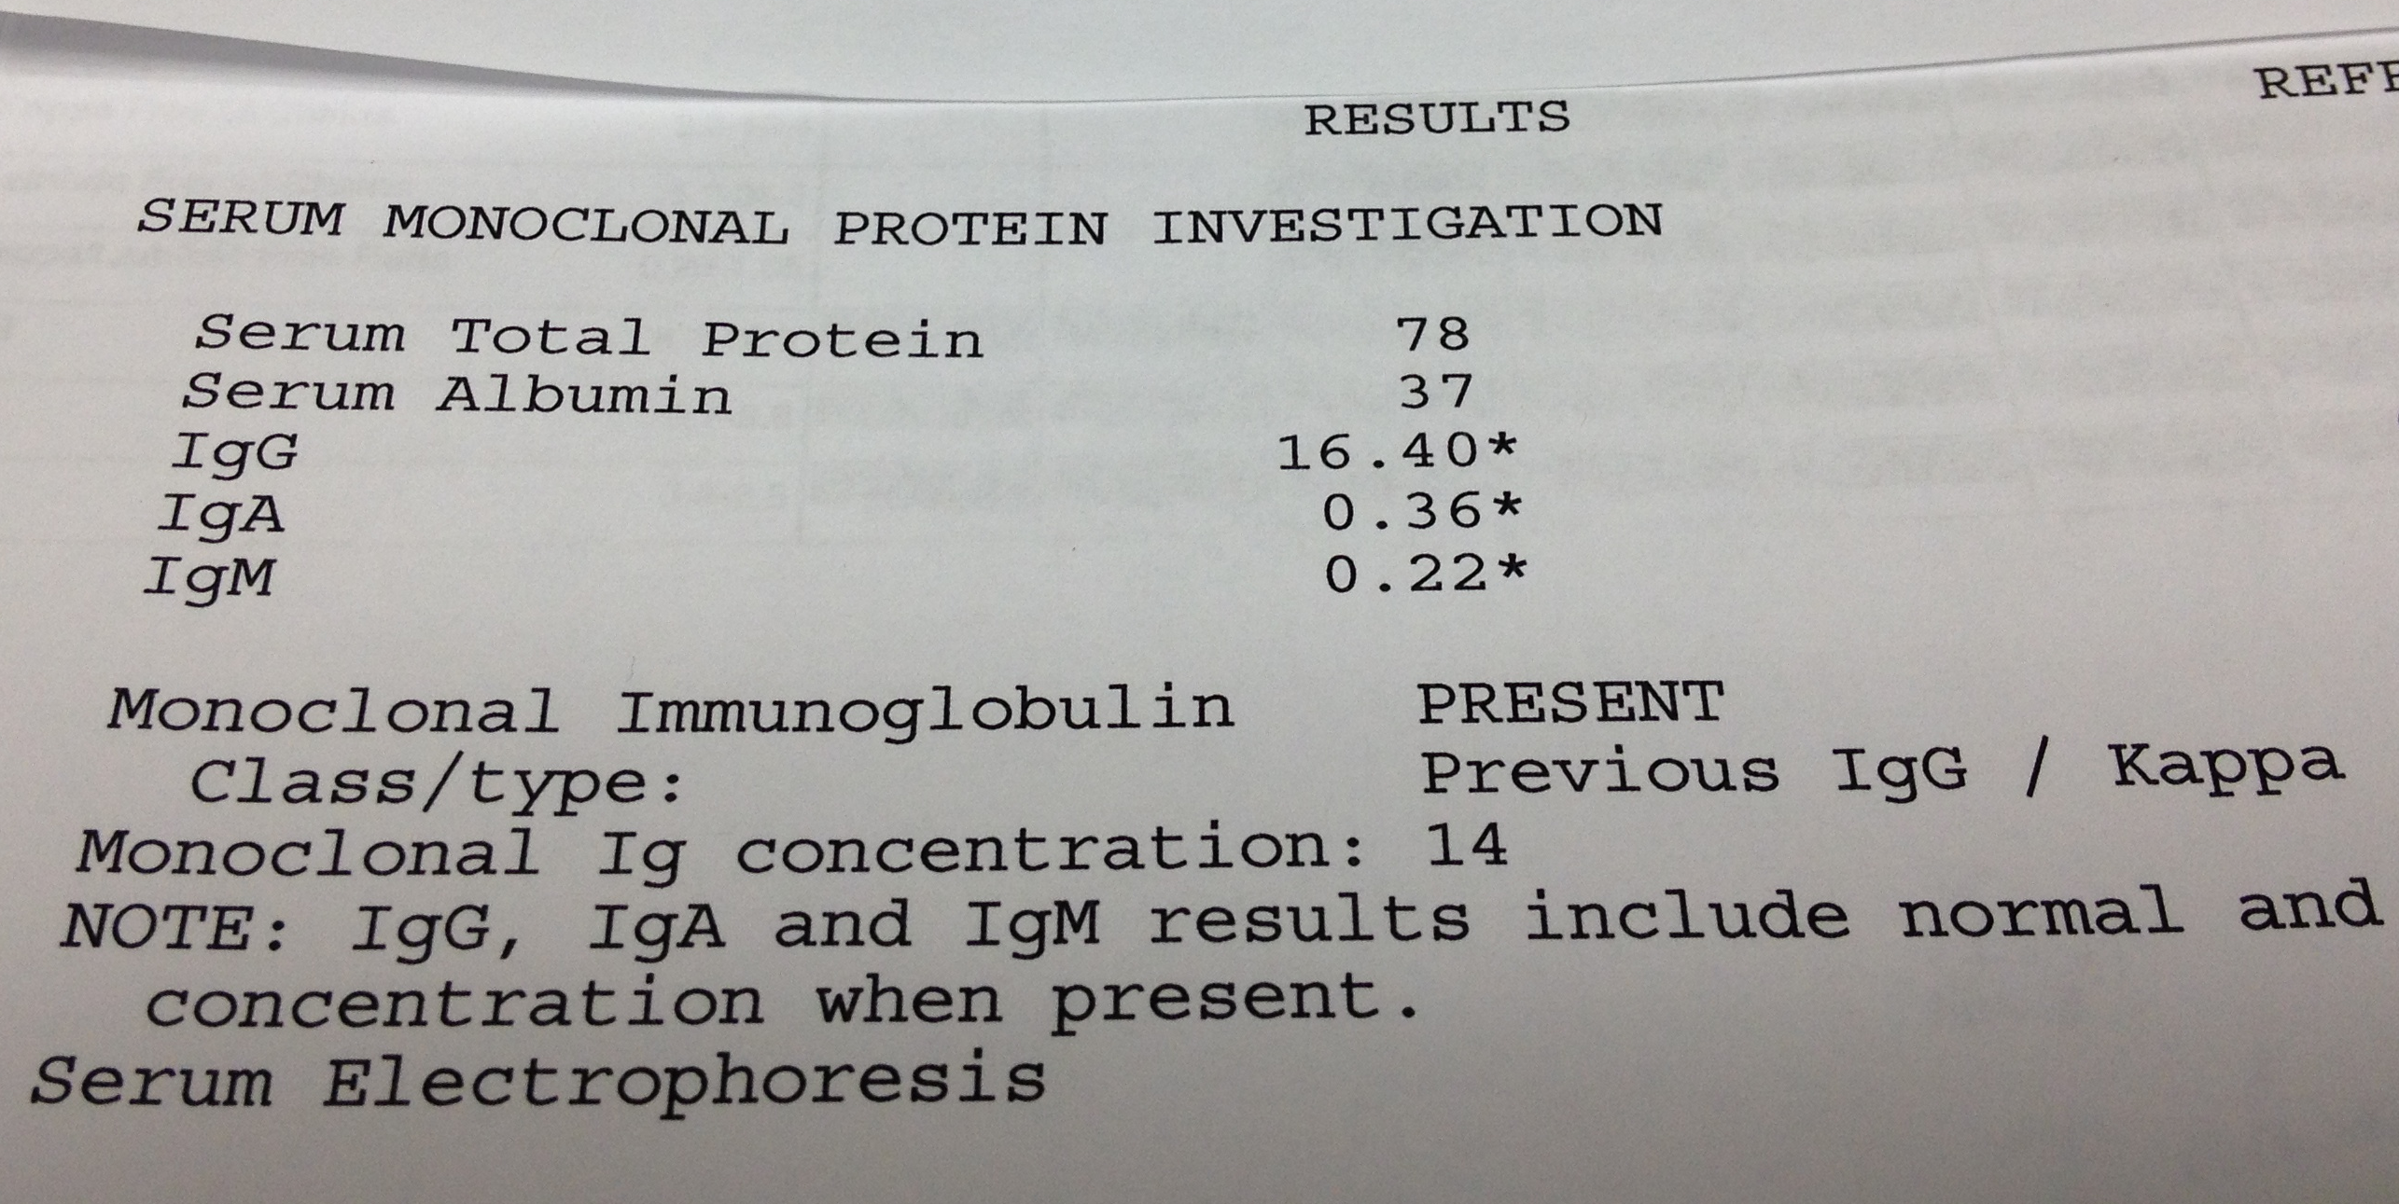

Slide 7
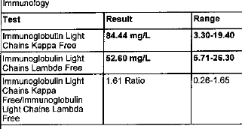

Slide 8
Urine protein electrophoresis
Does not improve sensitivity of multiple myeloma screening over SPEP + SFLC¹
Only valid if ordered on a 24 hour urine collection
  Low adherence rates, less convenient
McTaggart MP, Lindsay J, Kearney EM. Replacing urine protein electrophoresis with serum free light chain analysis as a first-line test for detecting plasma cell disorders offers increased diagnostic accuracy and potential health benefit to patients. Am J Clin Pathol. 2013;140(6):890‐897. doi:10.1309/AJCP25IHYLEWCAHJ

Slide 9
Quantitative immunoglobulins
Reports quantitative amount of IgG, IgA, IgM
  Elevated in inflammatory states
Does not help to determine clonality
Not required as part of the screening test for a patient suspected of multiple myeloma

Slide 10











Plasma cell function

Slide 11









Serum protein electrophoresis (SPEP)

Slide 12






































Slide 13





Slide 14








Slide 15










Slide 16
Free light chain assay
Immuno-assay targeting the exposed epitope of circulating free light chains
Free light chains are either kappa or lambda
In reactive states (inflammation, infection), the free light chains will be elevated but the ratio should not be abnormal
Normal ratio of kappa to lambda is 0.26-1.65
In patients with chronic renal insufficiency EGFR < 20, the accepted normal range is 0.37-3.05
Severely elevated free light chains in multiple myeloma lead to cast nephropathy

Slide 17


























Slide 18
Light chain secretory multiple myeloma
Malignant cell with deranged immune function
Secretes free light chain (committed to either kappa or lambda) without secreting a viable heavy chain immunoglobulin into circulation
Clonal proliferation of a light chain secretory clone will result in abnormality of the free light chain ratio, but with no detectable abnornmality in the SPEP
Light chain myeloma seen in 10-15% of cases

Slide 19



Slide 20
TESTS TO ORDER WHEN SUSPECTING MULTIPLE MYELOMA
SPEP + SFLC

Slide 21
Changes we have made
SPEP and SFLC are now a paired test
UPEP is now cancelled if ordered on a random specimen
“Renal range” of SFLC ratio is reported as a comment
24 hour UPEP is restricted to workup of renal amyloidosis and clinical trials

Slide 22
Take home message(s)
Order SPEP and SFLC for patients with suspected multiple myeloma
Quantitative immunoglobulin assays do not infer clonality
Abnormal ratios, not abnormal absolute values alone, suggest clonality on SFLC assay
Don’t order UPEP for suspected multiple myeloma
  it will get cancelled in Manitoba

Slide 23
Thank you
<arvand.barghi@gmail.com>

