Slide 1
Iron Chef: Serving up high quality care in the setting of iron deficiency and iron overload
Donald Houston MD PhD FRCPC
Emily Rimmer MD MSc. FRCPC
May 1, 2020

Slide 2
Part 1: Iron Homeostasis, Iron Overload, and Laboratory Measures of Iron
Donald S. Houston MD PhD FRCPC

Slide 3
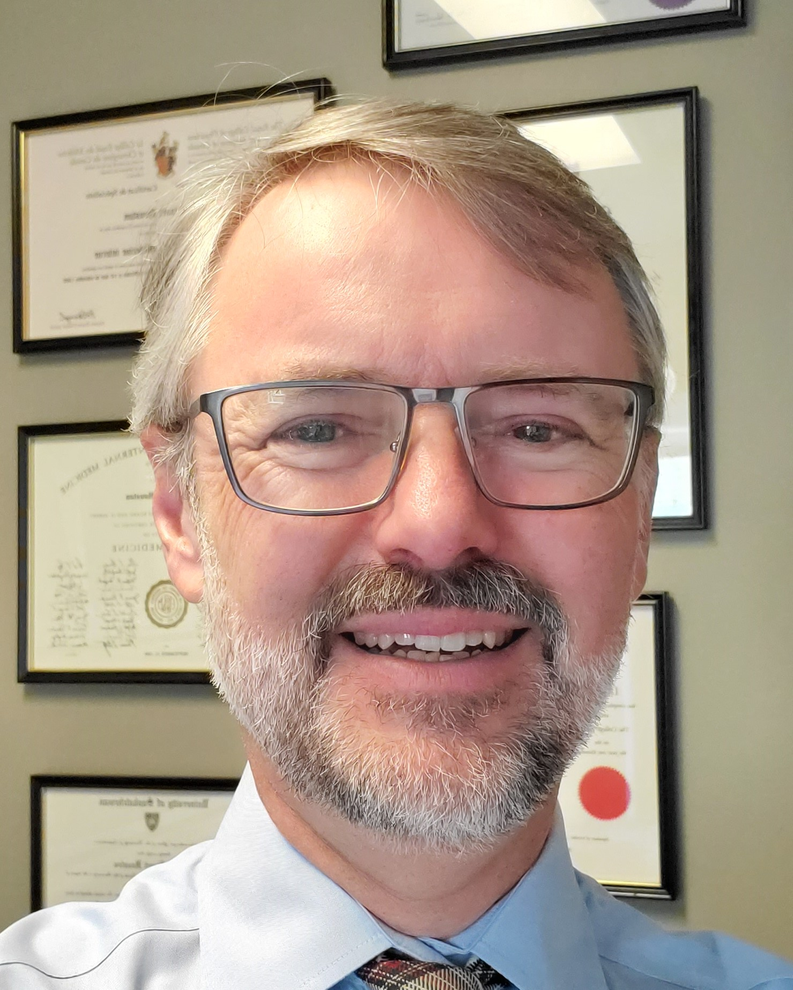
Presenter Disclosure
Speaker’s name: Donald S. Houston
Relationships with commercial interests:
  Grants/Research Support: None
  Speakers Bureau/Honoraria: None
  Consulting Fees: None
  Other: I don’t eat their food (and I don’t take iron)
Notes:
This slide must be visually presented to the audience AND verbalized by the speaker.

Slide 4
Mitigating Potential Bias
Not Applicable
Notes:
This slide must be visually presented to the audience AND verbalized by the speaker.

Slide 5
Learning Objectives
Explain the mechanisms by which the body regulates iron homeostasis, and how defects can lead to iron overload
Use simple tests (iron, TIBC, and ferritin) to sort out disorders of altered iron status
Apply strategies to manage iron deficiency and iron overload

Slide 6
Appetizer (empty calories)
Iron makes up a third of the mass of the Earth, and is 4th most abundant element in Earth’s crust (~5%)
Nonetheless iron is a limiting nutrient that is jealously conserved by the body
WHO 2011 estimate: anaemia affects around 800 million worldwide (mostly children and women, mostly iron deficiency)

Slide 7
Distribution of iron
Cell type / tissue | Amount
Red cells (hemoglobin) 1 unit of PRBCs ≈ 250mg | 2500mg
Storage (mainly liver, also splenic and bone marrow macrophages) | 1000mg
Enzymes, myoglobin etc. | 400mg
In plasma (bound to transferrin) | 4mg
Total | 4000mg
.005% of body mass

Slide 8
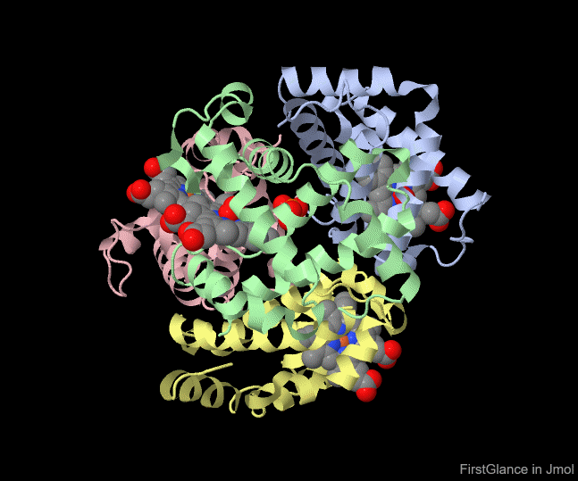
Hemoglobin Structure
Files:
bioinformatics.org/firstglance/fgij/fg.htm?mol=http://www.umass.edu/molvis/bme3d/materials/structures/1hho_quat.pdb.gz&

Slide 9
Heme

Slide 10
Daily Iron Flux
8mg ♂
18mg ♀
(RDA)
30mg
29mg
1-2mg
N.B.: there is no means to excrete iron
non-
absorbed
Losses
>7mg
1-2mg

Slide 11
Hepcidin

Slide 12
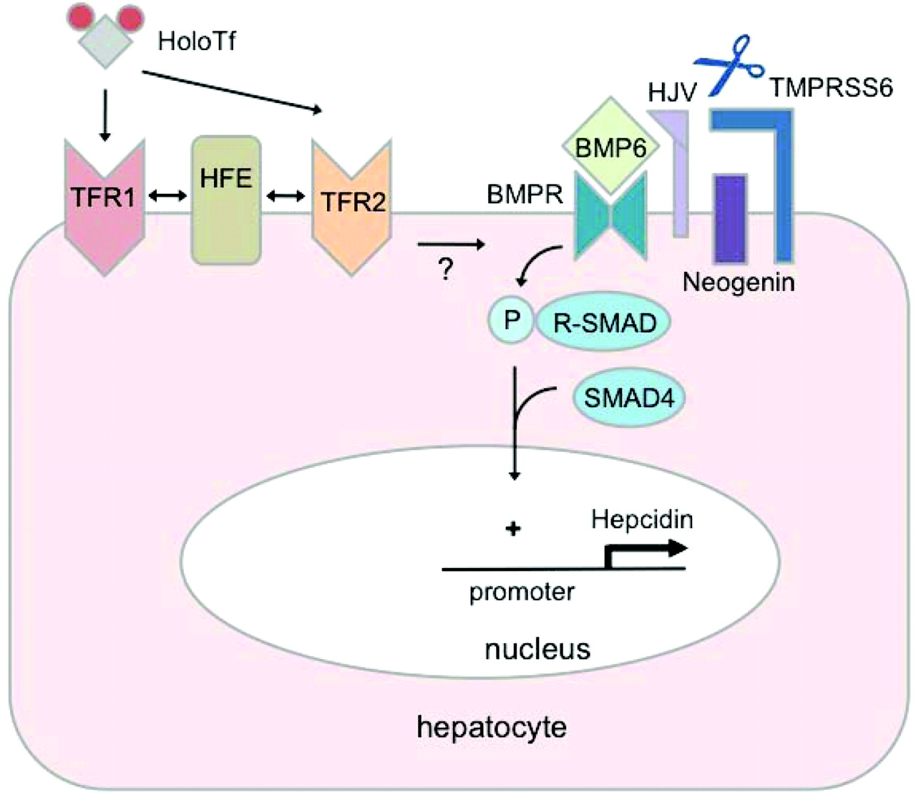
Hepcidin regulation
Adapted from Finberg KE.
Hematology 2011 pp. 532-7
+
Fe def.
iron
SMAD7
IL-6
STAT3
erythro
ferrone
BMP6
BMP6
?
Hypoxia
+/- epo
iron

Slide 13
Warning: Contents may be hot!
Free Radicals
Free iron is highly reactive
Generates free radicals by the Fenton reaction:
Ergo the body must keep iron under very tight control
E.g. K_{d} of transferrin is ~10⁻²⁰M
Fe²⁺ + H₂O₂ ----> Fe³⁺ + .OH + OH⁻
Fe³⁺ + H₂O₂ ----> Fe²⁺ + .OOH + H⁺
Do not
memorize!

Slide 14
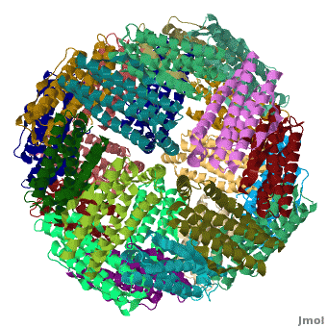
Safe iron handling
Ferritin is the primary intracellular storage protein for iron (the liver is the pantry)
  24-subunit spherical cage, tightly sequesters up to 4500 Fe³⁺ ions
  More iron => more ferritin synthesized
  Correlates with amount in plasma, though plasma ferritin has no evident function
Transferrin is the protein that transports iron through plasma to TfR-expressing cells
  Iron deficiency => increased transferrin synthesis
  Measured as Total Iron Binding Capacity (TIBC)
  i.e. TIBC = transferrin
Notes:
Good chef has to do safe food handling. Body needs safe iron handling
Plasma ferritin is a marker like plasma ALT
Mention iron response element

Slide 15
Too many cooks…
Iron & Acute phase response
Inflammatory signals (especially IL-6) trigger changes in hepatic synthesis of many plasma proteins
Ferritin increases
  like CRP or fibrinogen
Transferrin decreases
  like albumin
Hepcidin increases
  Sequestering iron in cells, so serum iron falls

Slide 16
Tests of Iron Status
 | Iron overload | Iron deficiency | Inflammation | Iron deficiency + inflammation
Hemoglobin | ↔ | ↓ | ↓ | ↓
MCV, MCHC | ↔ | ↓ | ↓ or ↔ | ↓
Serum iron | ↑ | ↓ | ↓ | ↓
TIBC | ↓ | ↑ | ↓ | ↔
Tsat | ↑** | ↓↓ | ↓ or ↔ | ↓
Ferritin | ↑ | ↓** | ↑ | ↔
Hepcidin* | ↑ | ↓ | ↑ | ↑ or ↔
*not available for routine clinical use **preferred test
TIBC = total iron binding capacity = transferrin
Tsat = transferrin saturation = serum iron / TIBC
Notes:
Always measure iron and TIBC together

Slide 17
Causes of Iron overload
Repeated transfusion (except if for bleeding)
Hereditary hemochromatosis
  Defect in sensing of iron status
  Inappropriately low hepcidin
  Ferroportin stays wide open
  Increased absorption and release of iron
  Tsat constitutively high
Ineffective erythropoiesis (e.g. thalassemia)
  High erythroferrone levels made by erythroid marrow
  Suppression of hepcidin
Advanced cirrhosis
  Impaired hepcidin synthesis due to liver failure
Notes:
Like a chef using a salt shaker with holes that are too big

Slide 18
Hepcidin regulation
Adapted from Finberg KE.
Hematology 2011 pp. 532-7
+
Fe def.
iron
SMAD7
IL-6
STAT3
erythro
ferrone
BMP6
BMP6
?
Hypoxia
+/- epo
iron

Slide 19
Hereditary hemochromatosis
Almost 10% of population of northern European stock are carriers of mutations in HFE gene
1/400 is homozygous for C282Y
Lifelong slow iron accumulation, typically not symptomatic until 50’s or 60’s
Women relatively protected until menopause
Penetrance (cirrhosis or heart failure) is incomplete
C282Y/H63D much milder iron loading, very low penetrance
If fasting Tsat persistently >45%, order HFE genotyping

Slide 20
Rust stains – Toxicities of Iron
Liver: hepatocellular injury (↑ transaminases), cirrhosis, hepatoma
Pituitary: hypogonadism (loss of libido, erectile dysfunction, amenorrhea), hypothyroidism
Pancreas: diabetes
Joints: arthritis classically 2nd and 3rd MCP joints
Heart: congestive failure and arrhythmias
Skin: darkening
Acute iron poisoning very different

Slide 21
Hemochromatosis - management
Phlebotomy
  500ml = 250mg of iron
  Bleed q1-2 weeks as Hb tolerates
  May require 40 or more units removed to reach iron neutral state
  Once ferritin <100, bleed ~4-6 times/year to keep ferritin in target range of 50 – 100
  Can often meet this need as blood donor

Slide 22
Causes of high ferritin
Iron overload: the minority!
  <10% of pts with high ferritin have hemochromatosis
Inflammation
  Infections, rheumatologic disorders, renal disease, cancer
Liver disease esp. fatty liver and alcohol excess
  Probably commonest cause
NB: recommended initial test if you suspect hereditary hemochromatosis is Tsat, not ferritin
If in doubt, liver iron can be measured by MRI
Notes:
Emphasize NOT the same as iron overload! Emphasize metabolic syndrome association with fatty liver

Slide 23
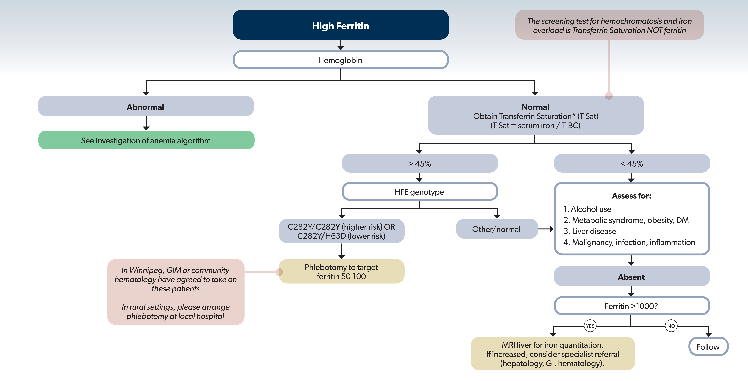

Slide 24
Iron Homeostasis: Take home
Iron status is maintained by regulating the absorption of iron
All patients with iron overload have elevated ferritin, but most elevated ferritin is reactive
  Tsat is preferred initial test for diagnosis of hemochromatosis
All tests (serum iron, TIBC, and ferritin) are influenced by both iron status and inflammation

Slide 25
Ode to hemochromatosis
When your HFE gene code is wrong,
Liver’s T2-star signal gets strong
‘cuz a lack of hepcidin
Has the bowel decidin’
To absorb extra Fe all day long

Slide 26
Thank you
donald.houston@umanitoba.ca

