Slide 1
Fractionated BDD 2
MGUS & Myeloma

Slide 2

Presenter Disclosure
Faculty: Mark Kristjanson
Relationships with commercial interests: none
Notes:
This slide must be visually presented to the audience AND verbalized by the speaker.

Slide 3
Mitigating Potential Bias
Not Applicable
Notes:
This slide must be visually presented to the audience AND verbalized by the speaker.

Slide 4
Learning Objectives
List the indications for SPEP & FLC
Adapt the diagnostic approach for patients with such indications to the clinical context

Slide 5
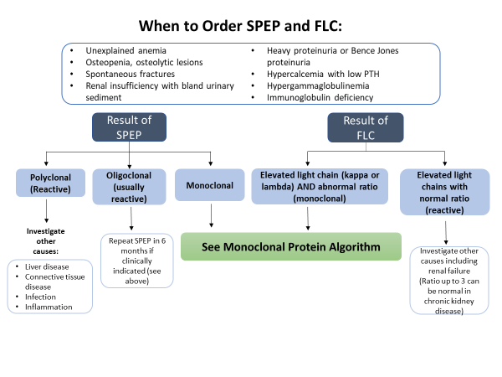

Slide 6
When not to order an SPEP and FLC
When a putative CRAB criterion (or neuropathy, or cardiomyopathy, etc.) is better explained by something else.
For example…

Slide 7
When not to order an SPEP and FLC
A 65 year old hypertensive female with type II DM x 17 years has a creatinine that has risen from 93 to 118 over the past three years
Microalbuminuria has progressed
A1c ranging 8.8% – 9.4% over that period
BPs ranging 128 – 144/88-94

Slide 8
When not to order an SPEP and FLC
That same diabetic patient presents at age 66 with mildly painful bilateral foot tingling paraesthesias
The tingling is relieved with amitriptyline 10 mg h.s.
Nerve conduction studies confirm a peripheral neuropathy consistent with a diabetic neuropathy

Slide 9
Would you order an SPEP and FLC?
A 59 year old female who is 10 years post -menopause
chronically loose bowels (3-4 movements per day)
Presents with T7 vertebral body compression
T-score on BMD -2.6
DDx?

Slide 10
Would you order an SPEP and FLC?
Diarrhea from AL amyloidosis of GI tract?
Celiac?
Other malabsorption syndromes?
Osteoporosis from multiple myeloma?
Primary hyperparathyroidism?
Hyperthyroidism?

Slide 11
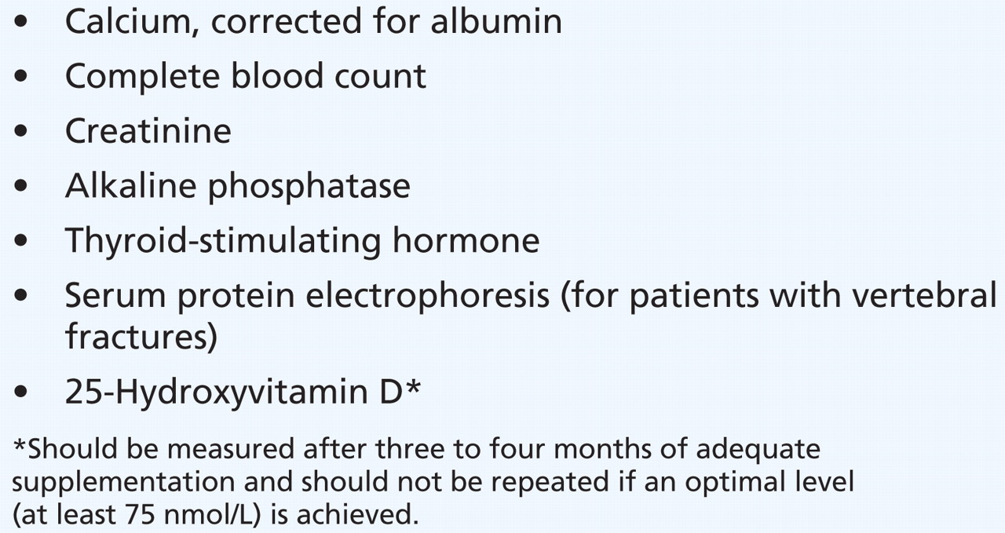

Osteoporosis Canada says: if osteoporosis (i.e. T-score ≤ −2.5), then
Notes:
Alexandra Papaioannou et al. CMAJ 2010;182:1864-1873

Slide 12
Would you order an SPEP and FLC?
Celiac screen & IgA level
CBC
Calcium, albumin, alk phos (+/- iPTH)
creatinine
Vitamin D
SPEP & FLC
TSH

Slide 13
Captain Crunch
54 year old male
Presents with mid-back pain x three weeks
Came on while mowing the lawn

Slide 14
Captain Crunch
Your differential?
What questions do you have for Mr. Crunch?
No previous similar pain
No trauma
Mild pain when lying still
Marked exacerbation with truncal movements

Slide 15
Captain Crunch
No fever
No limb weakness or sensory loss
No bladder or bowel symptoms
Acetaminophen 1 g QID plus ibuprofen 400 mg TID bring pain from an “8” to a “5” on 10.

Slide 16
Captain Crunch
On examination:
Painful limitation of forward flexion of spine
Sore in midline below inferior scapular angles
Punch tenderness at ~T12.
Motor & sensory exams lower limbs normal.

Slide 17
Captain Crunch
Investigations?
Plain radiographs of spine:
osteopenia;
25% loss of vertebral body height at T12
Anterior wedging
Next steps?

Slide 18
Osteoporosis Canada says: if osteoporosis (i.e. T-score ≤ −2.5), then
Notes:
Alexandra Papaioannou et al. CMAJ 2010;182:1864-1873

Slide 19
Captain Crunch
Hb 144 g/L
MCV 84.2 fL
Creatinine 73 umol/L
Ca++ 2.70 mmol/L (Corrected 2.73)
Alk phos 144
TSH 3.4 mU/L

Slide 20
Captain Crunch
Next steps?
iPTH (re: mild hypercalcemia)
SPEP & FLC
BMD

Slide 21
Captain Crunch
iPTH 12 ng/L (N: 17 – 60)
T-score -2.2
SPEP: IgG monoclonal protein 22 g/L
FLC:
Kappa 22.7 mg/L;
Lambda 19.7 mg/L;
FLCR 1.15

Slide 22
Captain Crunch
Diagnosis?
Myeloma
Next steps?
Skeletal survey
Refer to Hematology

Slide 23
Monoclonal Protein identified on SPEP or FLC
Are CRAB features present?**
C Ca²⁺ > 2.8
R renal :Creatinine > 177 or eGFR < 40 ml/min
A anemia: Hemoglobin less than 100 g/L
B bone: lytic bone lesions
**attributable to plasma disorder
Assess for CRAB features, order:
CBC
Creatinine
Ca²⁺
For IgM subtype, assess for lymphadenopathy and splenomegaly
Refer to Hematology
yes
No CRAB features
Are there any of the following high-risk features?
Non-IgG, Non-IgM monoclonal protein
Monoclonal protein > 15 g/L
Kappa or Lambda FLC > 100 mg/L
FLC ratio < 0.125 or > 8.0
Order skeletal survey
yes
no
See MGUS follow-up algorithm

Slide 24
MGUS follow up
Repeat CBC, calcium, creatinine, SPEP, and FLC
in 6 months
Possible progression:
M-protein increase by 5 g/L
FLC increase by 100 mg/L
FLC ratio becomes < 0.125 or > 8
New onset CRAB features
Stable
Refer to Hematology
Repeat CBC, calcium, creatinine, SPEP, and FLC
annually

