Slide 1
Cancer is Different for Adolescents and Young Adults
Ian Scott, MSW, RSW, Psychosocial Oncology
Dr. Anne Katz, Sexuality Counsellor, CCMB
Chris Yachison, AYA Patient
Dr. Brent Schacter, Hematology, CCMB
Dr. Geoff Cuvelier, Pediatric Oncology, CCMB
Notes:
As we begin our 2017 Conference…
Traditional Territories Recognition –– On Treaty 1 Land – Anishinaabe, Cree and Dakota peoples. Manitoba is also the heart of the Metis Nation. My family and I are white settlers on this land and I think taking time to recognize and demonstrate respect for these territories is a small, but important part of reconciliation.
The distinct challenges of young adults – title of workshop comes from Young Adult Cancer Canada
Will get to hear from a young adult cancer patient - Chris

Slide 2
Presenter Disclosure
Speaker: Ian Scott and Chris Yachison
Relationships with commercial interests:
None.

Slide 3
Mitigating Potential Bias
Not applicable – or is it?
Notes:
I bet this is the first time you’ve seen a cliffhanger like this on the mitigating potential bias slide.
Frame First- Facts Follow
Bias everywhere, within all of us
For me, my biases are impacted by my educational background, my family upbringing and personal experiences, from being a privileged white, heterosexual and cisgender man.
Recognizing these biases leads to more patient-centred and equitable care
On the topic of equity, Spoiler alert - You’ll get the opportunity to learn more about health equity tomorrow morning when Allison Wiens and Morgan Stirling from the Underserved Populations Program tell you all about it.

Slide 4
Learning Objectives:
Refer young adults with cancer to appropriate programs and resources to connect them with their peers
Understand the distinct challenges young adults with cancer face and commit to one concrete action to address these
Consider how to prepare young adults for transitions in care
Notes:
+ WORD CLUSTER DEBRIEF – back on screen
What understanding is audience coming from?
An AYA Patient Trajectory
Dr. Cuvelier and Dr. Schacter

Slide 5
The psychosocial and emotional impact of a cancer diagnosis on AYAs is substantial and multi-faceted
Source: https://www.etsy.com/search?q=path+walk
Notes:
As we settle in from break…
What we learned in first half of workshop about the AYA cancer trajectory…how a cancer diagnosis impacts adolescents and young adults in many respects, and I am going to walk us through the psychosocial considerations here, including the threat to identity, relationships, independence, career/education
Remembering the video we watched – Anika struggled at many points along her trajectory, her own experience, and often did not feel comfortable seeking help or know who to seek out
All-too common experience
Important health care system provides services that meet unique psychosocial needs of AYAs from diagnosis, through treatment and long-term survivorship and when needed palliative care.
So it’s not such an isolating experience
Underline that as we get started again – to remain mindful in your clinical care of the multiple psychosocial issues at play here
Stats – 7,600 Canadians diagnosed in 2013- CPAC
Incidence rate between 1992-2013
15-29 – up 18.2 %
30s -11.9 %

Slide 6
AYAs often encounter challenges and assumptions in the healthcare system
Source: https://litterboxconfidential.wordpress.com/tag/apology-tour/
Notes:
Not being patronizing or condescending, not making belittling comments (you’re the baby on the ward, just a wee little thing, only a kid, etc.
May be meant affectionately, but often perceived as pejorative
Not assuming someone else (i.e. a parent or caregiver) is overseeing their care
Practical advice - Speaking in a clear, understandable and respectful manner, checking for comprehension- this is good for all patients
It’s an opportunity to correctly inform these young patients about their treatment plan, rather than the patient trying to learn more details on Google and all the issues that brings.
Young adults aren’t looking for pity and don’t want to be infantilized, but want respect and quality care.

Slide 7
Disconnection from peers and friends can result in isolation and loneliness
Source: http://brainblogger.com/2006/05/15/anti-stigmatization-social-isolation-and-mental-illness/
Notes:
One of the take home messages- Time and again, adolescents and young adults cite social isolation and lack of peer connection as their biggest challenge when dealing with cancer
Anika video – Exile – to India for Tx and Canada alone as a young adult, but metaphorically as well. Feeling alienated from friends and family
Label that can stick that increases this sense of disconnection - Can become the “kid with cancer”, or the one in their friend group with cancer, cancer being the first thing people think of when they think of that particular friend
Friends falling away
Uncomfortable around illness
Saying the wrong thing
And this is happening at a time where the young person may be struggling with physical symptoms – and people might stop texting, stop asking if they want to get together
When a patient is older, their peer group is more likely to have had experiences with other health crises – for the friends of an adolescent or young adult, this could be the first time
Finding out who real friends are – at an age when peer relationships are increasingly important!
Not seeing similar-aged patients at CCMB (YACS)
To do:
Be aware of the isolation for one, be welcoming to AYAs
Connect to me for the group and online resources
Provincial resources – I am happy to connect with young patients across the province through telehealth- there are very active Facebook Groups, Online forums, Young Adult Cancer Canada has funding for Canada-wide retreats and conferences every year, there is a Young Adult Cancer Canada event called the Big Cancer Hook-up every year that young adults can watch from anywhere with a device and an internet connection
Announce for first time - Promote Localife* (dinner, drinks, gone to see a Fringe play, gone to Assinboia Downs, etc.) – started by a young adult patient
Our AYA patients can take advantage of this
Again – this is the number one concern that AYA patients bring up
JG - 4 types of people – do reach out (can be surprising), don’t reach out (can also be surprising and hurtful), let me know if you need anything – these people are useless, and then the weird people

Slide 8
Many AYAs experience forced dependence after diagnosis (moving back in with their parents for care)
Source: http://www.npr.org/series/352990765/new-boom
Notes:
This can provide some comfort and security, and isn’t an option for many AYAs who must cope on their own
Can represent a threat to independence
I support family members too – highly anxious and helicopter parents, distanced parents (See. A. Katz textbook)
Parents who look to the young adult for emotional support
And parents who respect the autonomy but are appropriately supportive
JG story - found it helpful to recuperate after chemo at parents, but suffocating after living on his own
Only so many times you can be offered tea in one hour…
Well-intentioned, keep offering her tea – “I don’t want any of your damn tea!”
Felt some shame, but overwhelmed
Another dynamic… This same patient had suspected his parents of using his younger sibling to get a message through to him – his sister asking if he thinks he should be driving out of nowhere
Lots written about teen-parent relationship – but not so much the unique relationship between young adults and their parents
- Young adults feeling cloistered and mildly or extremely annoyed with their parents, and the parents just trying to express concern and feeling bewildered at these apparent mood swings.

Slide 9
AYAs often have children of their own or are beginning to take care of aging parents
Source: http://moneycompass.com.my/en/the-sandwich-generation/
Notes:
And the other side of the last slide is the sandwich generation – this cohort of AYAs not moving back-in, but dealing with the diagnosis, caring for their own young children and their aging parents who have their own health concerns.
Caring for kids – wanting to be present as a parent – also can’t fully focus on recovery and self-care because of parenting and household responsibilities
Can’t just focus on being the patient, especially when you don’t have extra support and the kids can’t care for themselves

Slide 10
AYAs struggle with transitions to work and school
Source: http://www.cancer.net/blog/2016-06/when-you-cant-go-back-work-after-treatment-ends
Notes:
Work interruption, continuing work/school, returning to work/school
Anika in video – needing support in school – had recurrence, felt unable to ask for help, forcing herself through university- before eventually acknowledging her struggles and not being so hard on herself.
Limited understanding of cancer in general population
Questions of cognitive functioning after radiation to the brain – BRAIN FOG FOR UP TO 5 YEARS
Attitudes of coworkers – either having to support them as the patient, getting stuck with the cancer label, or having people wonder why you just aren’t back at work yet
I do some counselling in this area and connect patients to additional resources
Patient story – A young adult – questioning whether to disclose to a potential employer – question of silent hiring discrimination, perhaps needing some workplace accommodations, and we know what the human rights code says about this but filing complaints is not an easy process

Slide 11
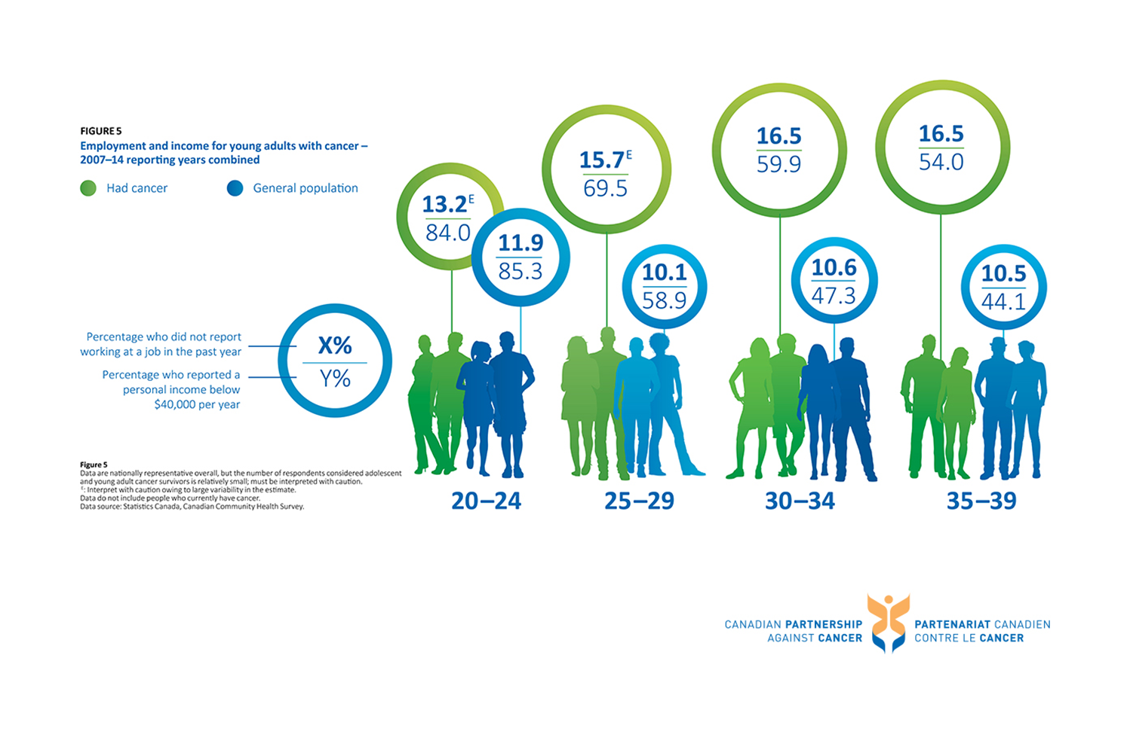
AYAs are more likely to experience financial stress, be unemployed and earn less than the general population (CPAC, 2017)
Notes:
Saw this image in Dr. Shachter’s presentation…
This graphic shows that the percentage of young adults with a cancer diagnosis report higher rates of unemployment and are more likely to earn less that $40,000/year
THE TAKEAWAY – AYAs earn less and are more likely to be unemployed 10 years after treatment, and this has a compounding effect, because they are earning less over many many years, perhaps missing out on promotions and career growths and falling further behind. So 10-20 plus years later, still earning significantly less
Finances - Shout out to Melanie Baruch – doing a short snapper presentation on the financial burden of cancer tomorrow at 3:30– for AYAs specifically, little to no CPP or EI contributions, no third party insurance (some have few financial concerns), little savings, minimal career training, limited financial literacy
If young adults don’t have the financial means to meet their basic needs, they are more likely to be underserved in multiple areas, and this is a big reason why AYAs are identified as an underserved population in our current Manitoba Cancer Plan.

Slide 12
Changes in appearance can affect self-esteem and body image
Source: CPAC, 2017
Notes:
changes to body (hair loss, weight loss or gain, energy changes)
Hair loss- sense of self – male patient – I like my curly hair, part of who I am, it doesn’t make it better if my other friends are going bald
PICC/PORT
Scarring, other bodily changes – DT – necessary, but a blow to self-esteem
Disclosing – do you tell on the 1st date? Conversation for the 3rd date? Do you put the fact you had cancer on your Tinder profile? Clothes on or clothes off? When do you talk about fertility? Whether you did or didn’t preserve eggs or sperm? Or do you just not date at all because of all the stress this causes?
-A current gap is in the accessibility of rehab services, with research demonstrating reduced rates of recurrence, improved quality of life, emotional adjustment and health outcomes with physical activity. This can help counteract the negative impact on self-esteem and body image I’m describing here.

Slide 13
Spiritual care should not be neglected in the AYA population
Source: https://huntsmancancer.org/circle-of-hope/2015/spiritual-care-services.php
Notes:
I think it’s well-known that the terms spirituality and religion are not synonymous with each other, with spirituality being much broader in scope and can include many manifestations, including meditation, closeness with nature, music and so on.
I’ve spoken to young patients about their faith or spirituality and many say it’s not part of their life, but I would say just as many or more say that it is. It plays out quite differently for different patients- many cite their spirituality or faith as a source a strength, but many patients have been left with the question “why me?” and some spiritual distress.
No matter how a patient integrates spirituality into their life, spirituality is often an overlooked component of patient care, yet quite fundamental when you consider the seemingly inevitable existential questions that arise with a cancer diagnosis, no matter the stage or type of cancer.
As a result of having to confront their own mortality, I think many adolescents and young adults develop an spiritual awareness and existential readiness that is far beyond their peers.
Simply asking patients about spirituality can be surprisingly insightful and lead to useful conversations about goals of care.

Slide 14
Facilitating successful transitions in care (to survivorship, from pediatric to adult care, to palliative care) is an ongoing area of need
Source: http://osullivanfield.com/10-transitions-every-leader-needs-to-master/
Notes:
3 different types of transitions I refer to on this slide
Survivorship is a distinct phase of cancer trajectory (Zebrack et al 2006)
transitioning to life post-cancer treatment, dealing with fear of recurrence, reentering workforce, starting family, dealing with lasting emotional impact of a cancer diagnosis (in psychosocial we see more people post-Tx (check with EP) because of the sense that you are well-supported through treatment and then transitioned out, but the impact is still there…)
MFAC AYA Document in Delegate bag – partnership with Community Oncology Program
Dr. Schacter talked about AYAs being caught between the pediatric and adult oncology realms…
Transitions in care – I see 15-35 – and many peds are followed in pediatrics – medicine different – care consistency – but slowing independence? – Peds to adult transitions – not wanting parents involved as they are with younger children – teen room (Kendra’s room) at CCMB
- More than we can unpack right now, but another difficult transition that requires considerable planning
Program in place: - Dr. Cuvelier referred to the longterm follow-up for young adults diagnosed as younger children
CAP clinic providing longer term follow-up for childhood cancer patients
And transitions from active, curative treatment to palliative treatment approaches and palliative care program, the QoL concerns that come along with it, involving the patient in decisions, etc.
TIME?
A patient story – young adult, early 20s not seeing an end to ongoing medical intervention and transitioning to palliative care – family very supportive but hoping he will continue treatment – sensitive to all of the views in the room, especially the patient and respecting their autonomy
One other huge issue when it comes to adolescents and young adults, so hand it over to Dr. Anne Katz…
EXTRA
Survivorship – has gone up –cite stats –(2004-2008) - 15-29 (86.3%) and 30-39 y/o 83.4% : this is at 6.2 % (15-29) and 9.8% (30-39) relative increase nationwide from the early 90s (1992-96)
Contextualize – more aggressive, worse survival rates than other groups

Slide 15
Small Group Case Studies
Notes:
10 minute discussion, 10 minute feedback
You have two sheets, with two case studies each – focus on the first one at the top of the page – don’t have to rush
Mic or text to word cluster

Slide 16
Concrete Action
Use the sticky notes on your table and write down one concrete action you will take to address the distinct challenges that young adults face
Attach the sticky note to the flipchart paper near the exit

Slide 17
Evaluations
Evaluations
Resources in delegate
bags, on table and
at AYA booth
Ian Scott – AYA Psychosocial Clinician
204-787-2191 – iscott@cancercare.mb.ca
Notes:
Here is my contact information
Evaluations of the table
I’ll be at the AYA table tomorrow, come say hi

