Slide 1
Practical Health Equity – An Interactive Experience
With Morgan & Allison
https://giphy.com/
Notes:
Best played as slideshow

Slide 2
Presenters: Morgan Stirling & Allison Wiens
Underserved Populations Program & Community Oncology
Commercial Interests:
None
But…
Notes:
Allison

Slide 3
Mitigating Potential Bias
Not applicable
Notes:
Allison

Slide 4
By the end of this presentation participants will be able to:
Become Health Equity Rockstars
Define Health Equity
Better understand the challenges patients from marginalised populations face
Use enhanced intervention skills to improve patient care
Notes:
Allison

Slide 5
What is Health Equity?
Health equity refers to the absence of avoidable or modifiable differences in health among populations or groups defined socially, economically, or geographically. These measurable health differences arise from underlying levels of social advantage/disadvantage, show a consistent pattern across the population, and are considered to be unfair.
- Public Health Agency of Canada
Health equity
In
Addressing the economic and social conditions that create barriers to people reaching their full health potential
Notes:
Morgan

Slide 6
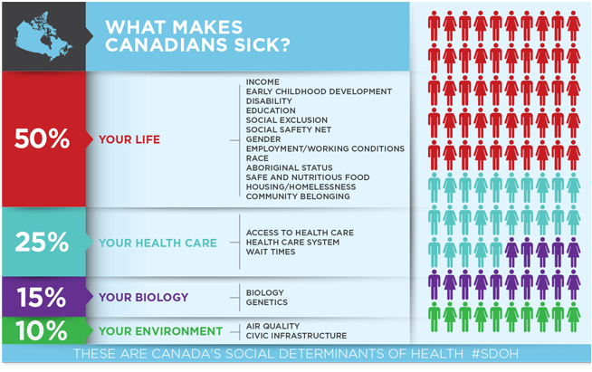
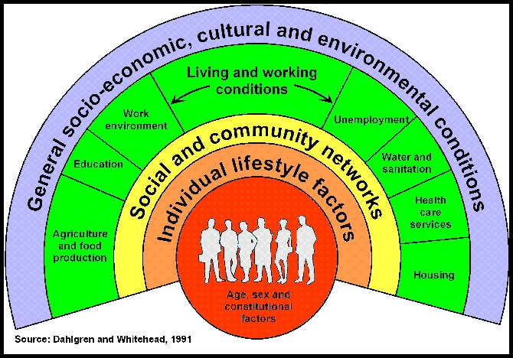
Economic & Social Conditions:
aka Social Determinants of Health
Health Care in Canada: What Makes Us Sick? 2013
2017 Community Cancer Care Educational Conference
Notes:
Allison
What do you see here…what I see.
-Canadian Medical Association 2013
-income, early development, access to food, housing, safety in your home and community, education, employment, race, gender
-25% is related to access to the health care system
20% of the $200 billion spent on health care annually can be attributed to socio-economic disparities1
Housing, food, income, education, early years’ education: all have more impact on our health than biology and our environment. We know that many of these health issues are largely out of the control of the individual and we also know we can fix them with policy. We know that the cost of inaction is far more expensive than acting ... it’s too expensive not to invest up front

Slide 7
Social Determinants across the Cancer Care Continuum
Income Ability Language Immigration Geography Employment Early Childhood Development Food Security Housing Social Exclusion Social Connection Health Gender Race ●
Screening
Diagnosis
Treatment
Survivorship/
End of Life
Developed by M. Stirling 2017
2017 Community Cancer Care Educational Conference
Notes:
Morgan

Slide 8
The reality of health equity at CancerCare Manitoba
transportation & travel, access, supports & services, government, jurisdictional barriers
Ambulatory Oncology Patient Satisfaction Survey 2016, Donna Turner, Carrie OConaill & Rajib Mian
2017 Community Cancer Care Educational Conference
Notes:
Morgan & Allison

Slide 9
What can you do?
2017 Community Cancer Care Educational Conference
Notes:
Morgan

Slide 10
What’s your WHY?
2017 Community Cancer Care Educational Conference
Notes:
Morgan & Allison

Slide 11
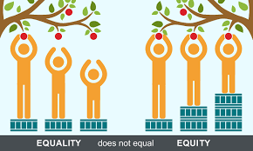
Health Equity: A Value and a Choice
https://healthequity.globalpolicysolutions.org/about-health-equity/
2017 Community Cancer Care Educational Conference
Notes:
Allison

Slide 12
Organization of Practice
Equity in Practice
Influence
Educate others about health equity
Be a role model
Advocate for services to support health equity
Support & Follow Up
Refer patients to support programs and services
Build relationships and trust for continuity of care
Provide information to access income/benefits
Patient advocacy: filling forms, letters, increased funding
Clinical Care
Dignity Question
Good Social History
Listen and Communicate At Patients Level
Consider and integrate SDOH
Screen for poverty
Adapted from WRHA Health for All, 2016
Ensure accessibility ● Person-centred & safe care ● Develop good working relationships with local services
2017 Community Cancer Care Educational Conference
Notes:
Morgan & Allison

Slide 13
Thank you!
https://giphy.com/
2017 Community Cancer Care Educational Conference

